Slide 1
SAEM Jeopardy
2018
Presented by
Sex & Gender in EM Interest Group
Academy for Women in Academic EM
Academy for Diversity and Inclusion in EM
Created by Jeannette Wolfe, MD

Slide 2
HERE ARE TODAY’S CATEGORIES
Notes:
Family Feud Template
Introduction Slide – Family Feud!

Slide 3

Basics

Slide 4
Male/Female

Slide 5
This and that*
*in original game was expert videos, modified for web posting due to size constraints

Slide 6
Research
Notes:
Treatment and procedures

Slide 7
1-2-3
Answers are three letter words or abbreviations
Notes:
Answers are five letters in either one or two words

Slide 8
Broken Hearts

Slide 9

Basic Definitions
Male or Female
This and That
Research
1-2-3
Broken Hearts
$100
$100
$100
$100
$100
$100
$200
$200
$200
$200
$200
$200
$300
$300
$300
$300
$300
$300
$400
$400
$400
$400
$400
$400
$500
$500
$500
$500
$500
$500
FINAL JEOPARDY

Slide 10
This refers to one’s chromosomal and hormonal make up

Slide 11
Biological Sex
next

Slide 12
Gender refers to the roles and expectations a person has within a sociocultural context
Next

Slide 13
Every cell has a sex every person has a gender
Canadian Institute of Health Research
next

Slide 14
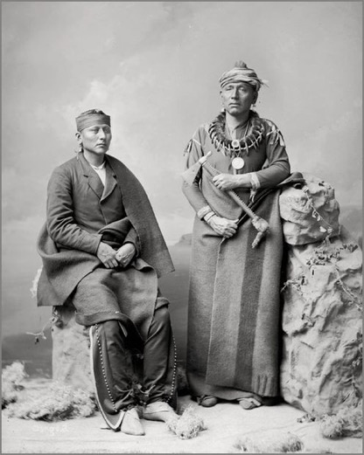
Two-spirited
Source: fundacionreflejosdevenezuelo.com

Slide 15
Correct term for someone who’s assigned sex at birth is female, has a male gender identity and is physically attracted to females

Slide 16
Transgender straight male
Next

Slide 17
Gender identity is distinct from sexual orientation

Slide 18
Significant distress caused when an individual’s assigned sex does not align with their gender identity

Slide 19
Gender Dysphoria
Notes:
http://www.soc.ucsb.edu/sexinfo/article/causes-intersexualityExamples
body dysmorphia causes someone to believe their body is a certain way, while gender dysphoria is a sense that the body should be a different way
Congenital adrenal hyperplasia
Androgen insensitivity syndrome
Klinefelters
Turners syndrome

Slide 20
The percentage of the 2017 medical school class that self-identified as LGBT
(within 3%)

Slide 21
8%
AAMC
next
Notes:
Native American/First Nations individuals who possess both male and female spirits
https://www.peacequarters.com/european-christians-forced-gender-roles-native-americans-acknowledged-5-genders/
“Female, Male, Two Spirit Female, Two Spirit Male and Transgendered.”

Slide 22
30%
LGBT medical students who conceal their sexual orientation during medical school

Slide 23
Which hand belongs to someone exposed to more prenatal testosterone
Notes:
One of the first studies to demonstrate sexual dichotomy in cell
death pathways was performed by Sampei et al. [111]. Neuronal nitric oxide synthase-deficient (nNOS−/−) male mice had
smaller infarcts after permanent middle cerebral artery occlusion compared to wild-type mice,

Slide 24
Hand on right
next

Slide 25
Testosterone
Organizational
- permanent wiring
next

Slide 27
Testosterone
Activatational
- temporary changes
- dominance
- competition
next
Notes:
Can shift assessment of tolerable risk

Slide 28

What’s right might be flipped to who’s right

Slide 29
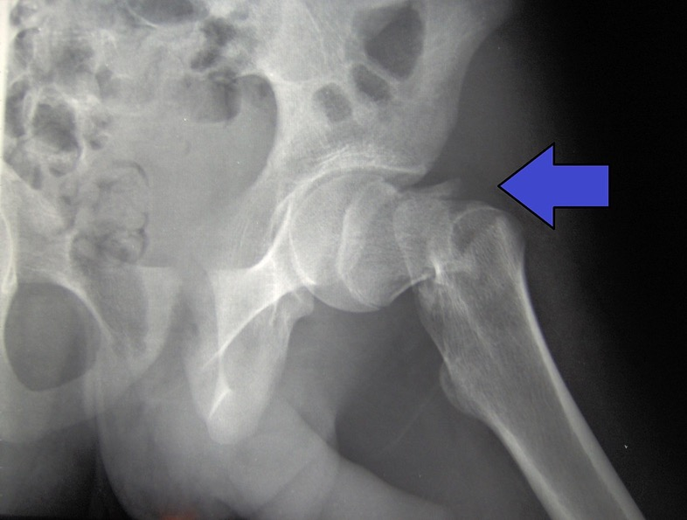
Higher mortality with this
Notes:
Get a hip fracture

Slide 30
Males
Next

Slide 31
Male
 | 1yr mortality
Women | 26%
Men | 37%
 | 1yr mortality
Women | 20%
Men | 27%
Kannegaard 2009
Age and Ageing
Schnell 2010
Geriatr Ortho Surg Rehab
Notes:
2012http://ageing.oxfordjournals.org/content/39/2/203.full
Introduction: osteoporosis is a common disease, and the incidence of osteoporotic fractures is expected to rise with the growing elderly population. Immediately following, and probably several years after a hip fracture, patients, both men and women, have a higher risk of dying compared to the general population regardless of age. The aim of this study was to assess excess mortality following hip fracture and, if possible, identify reasons for the difference between mortality for the two genders.
Methods: this is a nationwide register-based cohort study presenting data from the National Hospital Discharge Register on mortality, comorbidity and medication for all Danish patients (more than 41,000 persons) experiencing a hip fracture between 1 January 1999 and 31 December 2002. Follow-up period was until 31 December 2005.
Results: we found a substantially higher mortality among male hip fracture patients than female hip fracture patients despite men being 4 years younger at the time of fracture. Both male and female hip fracture patients were found to have an excess mortality rate compared to the general population. The cumulative mortality at 12 months among hip fracture patients compared to the general population was 37.1% (9.9%) in men and 26.4% (9.3%) in women. In the first year, the risk of death significantly increased for women with increasing age (hazard ratio, HR: 1.06, 95% confidence interval, CI: 1.06–1.07), the number of comedications (HR 1.04, 95% CI 1.03–1.05) and the presence of specific Charlson index components and medications described below. For men, age (HR 1.07, 95% CI 1.07–1.08), number of comedications (HR 1.06, 95% CI 1.04–1.07) and presence of different specific Charlson index components and medications increased the risk. Long-term survival analyses revealed that excess mortality for men compared with women remained strongly significant (HR 1.70, 95% CI 1.65–1.75, P < 0.001), even when controlled for age, fracture site, the number of medications, exposure to drug classes A, C, D, G, J, M, N, P, S and for chronic comorbidities.
Conclusion: excess mortality among male patients cannot be explained by controlling for known comorbidity and medications. Besides gender, we found higher age and multimorbidity to be related to an increased risk of dying within the first year after fracture; acute complications might be one of the explanations. This study emphasises the need for particular rigorous postoperative diagnostic evaluation and treatment of comorbid conditions in the male hip fracture patient.
Scott Schnell, MD,1 Susan M. Friedman, MD, MPH,1 Daniel A. Mendelson, MS, MD,1 Karilee W. Bingham, MS, RN, FNP,1 and Stephen L. Kates, MD1
Author information ► Copyright and License information ►
This article has been cited by other articles in PMC.
Go to:
Abstract
article-meta
Comanagement of geriatric hip fracture patients with standardized protocols has been shown to improve short-term outcomes after surgery. A standardized, patient-centered, comanaged Hip Fracture Program for Elders is examined for 1-year mortality. Patients ≥60 years of age who were treated in the Hip Fracture Program for Elders were comanaged by orthopaedic surgeons and geriatricians. Data including age, place of origin, procedure, length of stay, 1-year mortality, Charlson score, and activities of daily living (ADLs) were retrospectively collected. A total of 758 patients ≥60 years of age with hip fractures between April 15, 2005, and March 1, 2009, were included. Their data were analyzed, and the Social Security Death Index and the hospital data system were searched for mortality data. Seventy-eight percent were female, with a mean age of 84.8 years. The mean Charlson score was 3. Fifty percent were admitted from an institutional setting. The overall 1-year mortality was 21.2%. Age (odds ratio [OR] = 1.03, 95% confidence interval [CI] = 1.00-1.05; P = .02), male gender (OR = 1.55, 95% CI = 1.01-2.36; P = .04), low Parker mobility score (OR = 2.94, 95% CI = 1.31-6.57; P = .01), and a Charlson score of 4 or greater (OR = 2.15, 95% CI = 1.30-3.55; P = .002) were predictive of 1-year mortality. ADL dependence was a borderline predictor, as was medium Parker mobility score. Prefracture residence and moderate comorbidity (Charlson score of 2-3) were not independently predictive of mortality at 1 year after adjusting for other characteristics. A comprehensive comanaged hip fracture program for elders not only improves the short-term outcomes but also demonstrates a low 1-year mortality rate, particularly in patients from nursing facilities.

Slide 32
As a 3rd yr EM resident,
more likely to get higher ratings on milestone evaluations and more consistent feedback

Slide 33
Males
Next
Notes:
https://www.drugabuse.gov/publications/research-reports/substance-use-in-women/sex-gender-differences-in-substance-use
How and why men and women get addicted may be different

Slide 34
Dayal Jama Internal Med 2017
> 33,000 evals
no diff PG1
men > women PG3
  across all 23 competencies
  evaluator’s gender no change
next

Slide 35
Mueller Journal of Graduate Education 2017
- Comment Analysis
- Women more discordant feedback
  * autonomy & assertiveness
next

Slide 36
Upcoming June podcast with authors
sexandwhy.com

Slide 37
Who is more likely to be found in a shockable rhythm after cardiac arrest

Slide 38
Males
next
Notes:
.

Slide 39
LA ROSC study
 | Men | Women
shockable | 35% | 22%
STEMI | 32% | 23%
Survival/CPC 1-2 | 24% | 16%
Bosson JAHA 2016
Notes:
Sex Differences in Survival From Out-of-Hospital Cardiac Arrest in the
Era of Regionalized Systems and Advanced Post-Resuscitation Care
Nichole Bosson, MD, MPH; Amy H. Kaji, MD, PhD; Andrea Fang, MD; Joseph L. Thomas, MD; William J. French, MD; David Shavelle, MD;
James T. Niemann, MD
Background-—The purpose of this study was to evaluate sex differences in out-of-hospital cardiac arrest (OHCA) characteristics,
interventions, and outcomes.
Methods and Results-—This is a retrospective analysis from a regionalized cardiac arrest system. Data on patients treated for
OHCA are reported to a single registry, from which all adult patients were identified from 2011 through 2014. Characteristics,
treatment, and outcomes were evaluated with stratification by sex. The adjusted odds ratio (OR) for survival with good neurological
outcome (cerebral performance category 1 or 2) was calculated for women compared to men. There were 5174 out-of-hospital
cardiac arrests (OHCAs; 3080 males and 2094 females). Women were older, median 71 (interquartile range [IQR], 59–82) versus
66 years (IQR, 55–78). Despite similar frequency of witnessed arrest, women were less likely to present with a shockable rhythm
(22% vs 35%; risk difference [RD], 13%; 95% CI, 11–15), have ST-segment elevation myocardial infarction (23% vs 32%; RD, 13%;
95% CI, 7–11), or receive coronary angiography (11% vs 25%; RD, 14%; 95% CI, 12–16), percutaneous coronary intervention (5% vs
14%; RD, 9%; 95% CI, 7–11), or targeted temperature management (33% vs 40%; RD, 7%; 95% CI, 4–10). Women had decreased
survival to discharge (33% vs 40%; RD, 7%; 95% CI, 4–10) and a lower proportion of good neurological outcome (16% vs 24%; RD,
8%; 95% CI, 6–10). In multivariable modeling, female sex was not associated with decreased survival with good neurological
outcome (OR, 0.9; 95% CI, 0.8–1.1).
Conclusions-—Sex-related differences in OHCA characteristics and treatment are predictors of survival outcome disparities. With
adjustment for these factors, sex was not associated with survival or neurological outcome after OHCA. ( J Am Heart Assoc.
2016;5:e004131 doi: 10.1161/JAHA.116.004131)
Key Words: heart arrest • men • mortality • resuscitation
Intermediate
CPR
41%
39%
shockable
35%
22%
STEMI
32%
23%
Cath
25%
11%
TTM
40%
33%
Survival/CPC 1-2
24%
16%

Slide 40
Higher stroke risk from this

Slide 41
Females
Next

Slide 42
CHADS VASC
Notes:
J Cardiovasc Electrophysiol. 2007 Apr;18(4):415-21.

Slide 43
Standard needle decompression of pneumothorax less likely to work

Slide 44
Females
Next

Slide 45
Needle Thoracostomy
Men 35.6 mm
Women 43.3 mm
Laan Injury 2015
Notes:
38% failure rate in 5 cm overall

Slide 46
Sleeping pill with sex specific dose adjustment 20 years after FDA approval
Question originally recorded by Dr. Bruce Becker
Notes:
Due to size constraints video question removed for website hosting of game

Slide 47
Zolpidem
(Ambien)
Next

Slide 48
Zolpidem
sex differences
- pharmacokinetics
- pharmacodynamics
Next
Notes:
Same dose
- 40-70% diff plasma levels
Same plasma level
- Different cognitive effects
Greenblatt 2013 Pharmakokinetics/
Pharmacodynamics

Slide 49

Gender Differences
Wikipedia: Flaming June

Slide 50
Considering traditional cardiac risk factors
diabetes and this have a much greater weighted risk for CAD in women vs men
Question originally recorded by Dr .Angela Jarman
Next**
Notes:
Due to size constraints associated with website platform, video questions were removed
There is something quirkly about this particular slide within entire program in that you next to click next twice to moe it forward
https://www.fda.gov/ScienceResearch/SpecialTopics/WomensHealthResearch/ucm134670.htmSex differences in PK, PD from the moment a pill is consumed.
Women have longer baseline QTI due to Testosterone. Same prepuberty. After QT decreases it until 50yo.
QT depends on K channels opening during AP which repolarizes myocardial cell. More K channels open, the faster repolarization and the shorter the QT. T increases the number of K channels
Women have fewer K channels so more sensitive to QT prolongation drugs. This can result in PVT/Torsades.
A deadly ventricular arrythmia.

Slide 51
Smoking
Next

Slide 52
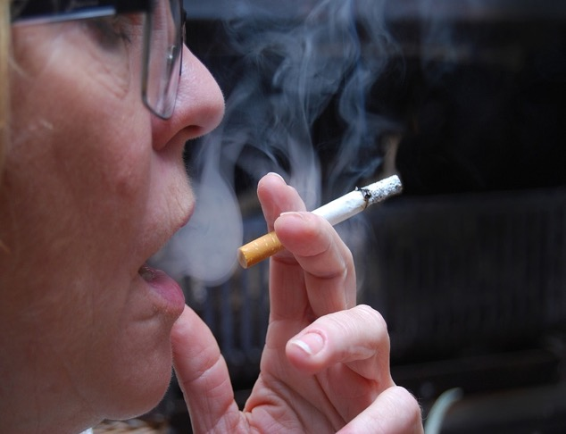
25% increased
risk

Slide 53
This common blood test has much greater sensitivity in men than women for diagnosing an MI
Question originally recorded by Dr. Basmah Safdar
Notes:
Due to size constraints associate with website platform video recordings were removed

Slide 54
Troponin
Next

Slide 55
Troponin
 | Conventional | HS
Men | 19% | 21%
Women | 11% | 22%
Shah BMJ 2015
Next

Slide 56
Women
- Smaller hearts
- Smaller trop leak
- Different pathophysiology
Next

Slide 57
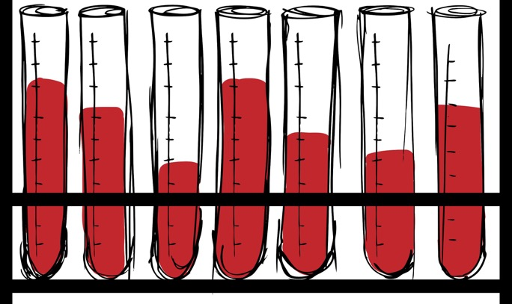
Other labs with sex specific cut offs
- Creatinine
- Uric Acid
- Hemoglobin
- Calcium
- Cholesterol

Slide 58
This enzyme is more revved up in men and likely contributes to their decreased blood alcohol level compared to a women’s for similar alcohol consumption
Question originally recorded by Dr. Esther Choo
Notes:
Unfortunately, due to size of recorded video, it needed to be removed for website hosting of game

Slide 59
Alcohol Dehydrogenase
Next

Slide 60
Enzyme revved up by testosterone and likely also contributes to decreased zolpidem absorption in men

Slide 61
Women are at greater risk for for sudden death by drugs that do this
Question originally recorded by Dr. Alyson McGregor
Notes:
Unfortunately due to size constraints, recorded videos questions had to be removed for website game hosting

Slide 62
QTc
next

Slide 63
Women account for 70% QTc deaths
- Testosterone K+ channels
- K+ channels faster
repolarization
Oskui J of American Heart Association 2013
next
Notes:
Sex differences in PK, PD from the moment a pill is consumed.
Women have longer baseline QTI due to Testosterone. Same prepuberty. After QT decreases it until 50yo.
QT depends on K channels opening during AP which repolarizes myocardial cell. More K channels open, the faster repolarization and the shorter the QT. T increases the number of K channels
Women have fewer K channels so more sensitive to QT prolongation drugs. This can result in PVT/Torsades.
A deadly ventricular arrythmia.

Slide 64
Gender
Women go to doctor more
Women get more scripts
next

Slide 65

Obstetrics and Gynecology International 2017
KesselsKramer.com

Slide 66
Funding agencies, IRBs and journal editors are increasingly requiring that researchers include this biological variable in their study design and analysis

Slide 67
Sex
Notes:
Differences in hormones
https://www.cdc.gov/mmwr/preview/mmwrhtml/su6001a18.htm

Slide 68
In a recent sampling of 2008-2013 RCT from major journals, this % of studies had unexplained over-representation of males
(within 10%)

Slide 69
43%
Phillips et al Global Health Action 2016
Next
Notes:
Doubly blind: a systematic review of gender in randomised controlled trials
Susan P. Phillips & Katarina Hamberg
Article: 29597 | Received 01 Sep 2015, Accepted 21 Feb 2016, Published online: 15 Apr 2016
Article: 29597 | Received 01 Sep 2015, Accepted 21 Feb 2016, Published online: 15 Apr 2016
Download citation http://dx.doi.org.ezproxy.library.tufts.edu/10.3402/gha.v9.29597 CROSSMARK_Color_horizontal.svg
In this article
Introduction
Methods
Results
Discussion
Conclusion
Authors' contributions
Conflict of interest and funding
References
Full Article Figures & data References Citations Metrics Licencing PDF
abstract content
Abstract
Background
Although observational data show social characteristics such as gender or socio-economic status to be strong predictors of health, their impact is seldom investigated in randomised controlled studies (RCTs).
Objective & design
Using a random sample of recent RCTs from high-impact journals, we examined how the most often recorded social characteristic, sex/gender, is considered in design, analysis, and interpretation. Of 712 RCTs published from September 2008 to 31 December 2013 in the Annals of Internal Medicine, British Medical Journal, Lancet, Canadian Medical Association Journal, or New England Journal of Medicine, we randomly selected 57 to analyse funding, methods, number of centres, documentation of social circumstances, inclusion/exclusion criteria, proportions of women/men, and reporting about sex/gender in analyses and discussion.
Results
Participants’ sex was recorded in most studies (52/57). Thirty-nine percent included men and women approximately equally. Overrepresentation of men in 43% of studies without explicit exclusions for women suggested interference in selection processes. The minority of studies that did analyse sex/gender differences (22%) did not discuss or reflect upon these, or dismissed significant findings. Two studies reinforced traditional beliefs about women's roles, finding no impact of breastfeeding on infant health but nevertheless reporting possible benefits. Questionable methods such as changing protocols mid-study, having undefined exclusion criteria, allowing local researchers to remove participants from studies, and suggesting possible benefit where none was found were evident, particularly in industry-funded research.
Conclusions
Social characteristics like sex/gender remain hidden from analyses and interpretation in RCTs, with loss of information and embedding of error all along the path from design to interpretation, and therefore, to uptake in clinical practice. Our results suggest that to broaden external validity, in particular, more refined trial designs and analyses that account for sex/gender and other social characteristics are needed.
Doubly blind: a systematic review of gender in randomised controlled trials
Susan P. Phillips & Katarina Hamberg
Article: 29597 | Received 01 Sep 2015, Accepted 21 Feb 2016, Published online: 15 Apr 2016
Article: 29597 | Received 01 Sep 2015, Accepted 21 Feb 2016, Published online: 15 Apr 2016
Download citation http://dx.doi.org.ezproxy.library.tufts.edu/10.3402/gha.v9.29597 CROSSMARK_Color_horizontal.svg
In this article
Introduction
Methods
Results
Discussion
Conclusion
Authors' contributions
Conflict of interest and funding
References
Full Article Figures & data References Citations Metrics Licencing PDF
abstract content
Abstract
Background
Although observational data show social characteristics such as gender or socio-economic status to be strong predictors of health, their impact is seldom investigated in randomised controlled studies (RCTs).
Objective & design
Using a random sample of recent RCTs from high-impact journals, we examined how the most often recorded social characteristic, sex/gender, is considered in design, analysis, and interpretation. Of 712 RCTs published from September 2008 to 31 December 2013 in the Annals of Internal Medicine, British Medical Journal, Lancet, Canadian Medical Association Journal, or New England Journal of Medicine, we randomly selected 57 to analyse funding, methods, number of centres, documentation of social circumstances, inclusion/exclusion criteria, proportions of women/men, and reporting about sex/gender in analyses and discussion.
Results
Participants’ sex was recorded in most studies (52/57). Thirty-nine percent included men and women approximately equally. Overrepresentation of men in 43% of studies without explicit exclusions for women suggested interference in selection processes. The minority of studies that did analyse sex/gender differences (22%) did not discuss or reflect upon these, or dismissed significant findings. Two studies reinforced traditional beliefs about women's roles, finding no impact of breastfeeding on infant health but nevertheless reporting possible benefits. Questionable methods such as changing protocols mid-study, having undefined exclusion criteria, allowing local researchers to remove participants from studies, and suggesting possible benefit where none was found were evident, particularly in industry-funded research.
Conclusions
Social characteristics like sex/gender remain hidden from analyses and interpretation in RCTs, with loss of information and embedding of error all along the path from design to interpretation, and therefore, to uptake in clinical practice. Our results suggest that to broaden external validity, in particular, more refined trial designs and analyses that account for sex/gender and other social characteristics are needed.

Slide 70
Selection & exclusion
Limited analysis
Limited discussion

Slide 71
Currently both sexes must be studied in new drugs trials. Not so for bioequivalent releases.
What % of drugs currently prescribed are generic?
(within 10%)

Slide 72
80%
Next

Slide 73
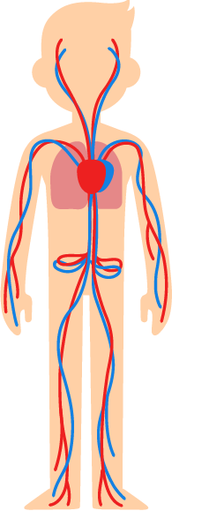
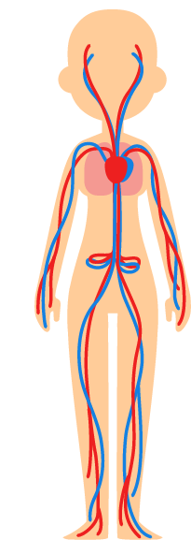
Generics
=
Koren, Clinical Pharmacology Therapy 2013
Notes:
Differences in bioequalvency between men and women
Intrasubject variability
Hormonal status
And different responses to “iert”
80% of prescription drugs are generic
http://www.clinicaltherapeutics.com/article/S0149-2918(16)30920-1/fulltext
Bioequivalency between men and women in generics is different than reference drugs often because the equivalency studies for the fda are usually done on male only
In 2000, the FDA’s Center for Drug Evaluation and Research demonstrated statistically significant differences between men and women in bioequivalence for most generic drugs compared with reference drugs; these differences were most likely the result of intrasubject variability, hormonal status, and the way in which men and women metabolize the inactive ingredients.⁵ These differences become significant, as 80% of the prescriptions filled in the United States are for the generic equivalent.⁶In 2000, the FDA’s Center for Drug Evaluation and Research demonstrated statistically significant differences between men and women in bioequivalence for most generic drugs compared with reference drugs; these differences were most likely the result of intrasubject variability, hormonal status, and the way in which men and women metabolize the inactive ingredients.⁵ These differences become significant, as 80% of the prescriptions filled in the United States are for the generic equivalent.⁶

Slide 74
A recent analysis of medical device approval studies showed that men and women were included in >90% of studies.
What percentage did sex specific analysis of their data? (within 5%)
Next

Slide 75
17%
next

Slide 76
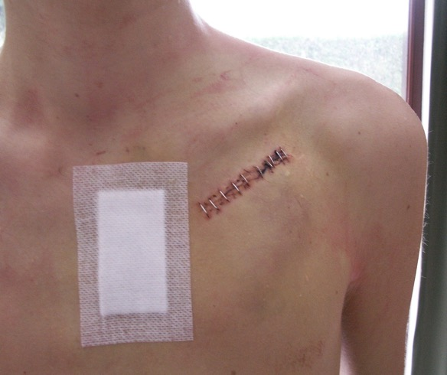
2015 FDA data
82 studies
17% sex
9% age
4% race
Dhruva Jama Internal Med 2017
Notes:
https://medicalxpress.com/news/2017-07-safety-medical-devices-sex-age.html
Sanket S. Dhruva et al. Inclusion of Demographic-Specific Information in Studies Supporting US Food & Drug Administration Approval of High-Risk Medical Devices, JAMA Internal Medicine (2017). DOI: 10.1001/jamainternmed.2017.3148
The researchers examined 82 studies filed in 2015 with the U.S. Food and Drug Administration (FDA) in support of premarket approval for original medical devices. Of the 77 studies that included both men and women, only 17% were analyzed by sex. Only 9% were analyzed by age and 4% by race.

Slide 77
In 2015 the NIH
required that basic scientists doing
animal research
do this

Slide 78
Include male and female animals
Pixabay
Next
Notes:
NIH policy on the consideration of sex as a biological variable. Anticipated changes to FY2016 research grant applications, to be in effect for FY2017 funding, will include accounting for sex as a biological variable in the Research Strategy section. In this section, applicants are asked to “explain how relevant biological variables, such as sex, are factored into research designs and analyses for studies in vertebrate animals and humans.” Furthermore, “strong justification from the scientific literature, preliminary data, or other relevant considerations, must be provided for applications proposing to study only one sex.” Anticipated changes to review criteria will include evaluation of the adequacy of the research plan with regard to consideration of sex as a biological variable.
he Research for All Act of 2015 amends the Public Health Service Act to require the NIH to ensure that basic research projects include both male and female cells, tissues, or animals. CooperJ. H.R. 2101—Research Act for All 2015. https://www.congress. gov/bill/114th-congress/house-bill/ 2101.

Slide 79

Morning Harry,
Harry, Harry, Harry, Harry,
Harry and Harry. Wait, has anyone seen Harriet?
Next
Notes:
Female rates are going to screw up data

Slide 80
Beery Neuroscience and Behavioral Reviews 2011
Notes:
Female mammals have long been neglected in biomedical research. The NIH mandated enrollment of
women in human clinical trials in 1993, but no similar initiatives exist to foster research on female
animals.Wereviewed sex bias in research on mammals in 10 biological fields for 2009 and their historical
precedents. Male bias was evident in 8 disciplines and most prominent in neuroscience, with single-sex
studies of male animals outnumbering those of females 5.5 to 1. In the past half-century, male bias in nonhuman
studies has increased while declining in human studies. Studies of both sexes frequently fail to
analyze results by sex. Underrepresentation of females in animal models of disease is also commonplace,
and our understanding of female biology is compromised by these deficiencies. The majority of articles
in several journals are conducted on rats and mice to the exclusion of other useful animal models. The
belief that non-human female mammals are intrinsically more variable than males and too troublesome
for routine inclusion in research protocols is without foundation. We recommend that when only one
sex is studied, this should be indicated in article titles, and that funding agencies favor proposals that
investigate both sexes and analyze data by sex.
10 fields
8 bias
worse neuro science all male 5.5 verusus all female
1. If male and female animal models are thought to differ in
response to an intervention then the study must be designed
with adequate sample sizes to answer the question for each sex.
2. If prior research strongly indicates that there are no significant
differences between male and female animals, then sex is not
required in subject sex selection, but study of both males and
females is both feasible and encouraged.
3. If information about the existence of sex differences is absent or
equivocal then both sexes should be studied in numbers sufficient
to permit valid analysis.
4. Study of mechanisms underlying sex differences should be a high
priority.
5. Outreach training activities offering practical suggestions and
additional sources of information should be made available by
theNIHto help investigators design studies that fully incorporate
female animals.
6. The review process for extramural funding should treat inclusion
of female animals as amatter of scientific merit that affects
funding.

Slide 81
The abbreviation for this commonly used drug that has been shown to help men but not women prevent an initial heart attack

Slide 82
ASA
Notes:
http://ageing.oxfordjournals.org/content/39/2/203.full
Introduction: osteoporosis is a common disease, and the incidence of osteoporotic fractures is expected to rise with the growing elderly population. Immediately following, and probably several years after a hip fracture, patients, both men and women, have a higher risk of dying compared to the general population regardless of age. The aim of this study was to assess excess mortality following hip fracture and, if possible, identify reasons for the difference between mortality for the two genders.
Methods: this is a nationwide register-based cohort study presenting data from the National Hospital Discharge Register on mortality, comorbidity and medication for all Danish patients (more than 41,000 persons) experiencing a hip fracture between 1 January 1999 and 31 December 2002. Follow-up period was until 31 December 2005.
Results: we found a substantially higher mortality among male hip fracture patients than female hip fracture patients despite men being 4 years younger at the time of fracture. Both male and female hip fracture patients were found to have an excess mortality rate compared to the general population. The cumulative mortality at 12 months among hip fracture patients compared to the general population was 37.1% (9.9%) in men and 26.4% (9.3%) in women. In the first year, the risk of death significantly increased for women with increasing age (hazard ratio, HR: 1.06, 95% confidence interval, CI: 1.06–1.07), the number of comedications (HR 1.04, 95% CI 1.03–1.05) and the presence of specific Charlson index components and medications described below. For men, age (HR 1.07, 95% CI 1.07–1.08), number of comedications (HR 1.06, 95% CI 1.04–1.07) and presence of different specific Charlson index components and medications increased the risk. Long-term survival analyses revealed that excess mortality for men compared with women remained strongly significant (HR 1.70, 95% CI 1.65–1.75, P < 0.001), even when controlled for age, fracture site, the number of medications, exposure to drug classes A, C, D, G, J, M, N, P, S and for chronic comorbidities.
Conclusion: excess mortality among male patients cannot be explained by controlling for known comorbidity and medications. Besides gender, we found higher age and multimorbidity to be related to an increased risk of dying within the first year after fracture; acute complications might be one of the explanations. This study emphasises the need for particular rigorous postoperative diagnostic evaluation and treatment of comorbid conditions in the male hip fracture patient.
Scott Schnell, MD,1 Susan M. Friedman, MD, MPH,1 Daniel A. Mendelson, MS, MD,1 Karilee W. Bingham, MS, RN, FNP,1 and Stephen L. Kates, MD1
Author information ► Copyright and License information ►
This article has been cited by other articles in PMC.
Go to:
Abstract
article-meta
Comanagement of geriatric hip fracture patients with standardized protocols has been shown to improve short-term outcomes after surgery. A standardized, patient-centered, comanaged Hip Fracture Program for Elders is examined for 1-year mortality. Patients ≥60 years of age who were treated in the Hip Fracture Program for Elders were comanaged by orthopaedic surgeons and geriatricians. Data including age, place of origin, procedure, length of stay, 1-year mortality, Charlson score, and activities of daily living (ADLs) were retrospectively collected. A total of 758 patients ≥60 years of age with hip fractures between April 15, 2005, and March 1, 2009, were included. Their data were analyzed, and the Social Security Death Index and the hospital data system were searched for mortality data. Seventy-eight percent were female, with a mean age of 84.8 years. The mean Charlson score was 3. Fifty percent were admitted from an institutional setting. The overall 1-year mortality was 21.2%. Age (odds ratio [OR] = 1.03, 95% confidence interval [CI] = 1.00-1.05; P = .02), male gender (OR = 1.55, 95% CI = 1.01-2.36; P = .04), low Parker mobility score (OR = 2.94, 95% CI = 1.31-6.57; P = .01), and a Charlson score of 4 or greater (OR = 2.15, 95% CI = 1.30-3.55; P = .002) were predictive of 1-year mortality. ADL dependence was a borderline predictor, as was medium Parker mobility score. Prefracture residence and moderate comorbidity (Charlson score of 2-3) were not independently predictive of mortality at 1 year after adjusting for other characteristics. A comprehensive comanaged hip fracture program for elders not only improves the short-term outcomes but also demonstrates a low 1-year mortality rate, particularly in patients from nursing facilities.

Slide 83
The ____
is slowly fading out the “lettering” category of a drug’s supposed pregnancy risk

Slide 84
FDA
next

Slide 85
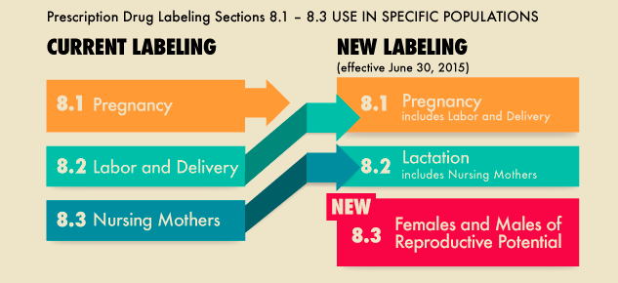
Pregnancy and Lactation Labeling Rule (PLLR)
next
Notes:
he PLLR requires changes to the content and format for information presented in prescription drug labeling in the Physician Labeling Rule (PLR) format to assist health care providers in assessing benefit versus risk and in subsequent counseling of pregnant women and nursing mothers who need to take medication, thus allowing them to make informed and educated decisions for themselves and their children. The PLLR removes pregnancy letter categories – A, B, C, D and X. The PLLR also requires the label to be updated when information becomes outdated.
As of November 2017, the FDA said the labels on more than 500 drugs had been converted under the new rule. The FDA says the process is on track to be completed on schedule by 2020.
The new labels include what the FDA describes as integrated, narrative summaries of the risks of the prescription drugs or biological products for the woman, the fetus, the breastfeeding infant and the reproductive potential of both men and women.
https://s3.amazonaws.com/public-inspection.federalregister.gov/2014-28241.pdf
https://www.fda.gov/Drugs/DevelopmentApprovalProcess/DevelopmentResources/Labeling/ucm093307.htm
Labeling for over-the-counter (OTC) medicines will not change; OTC drug products are not affected by the final rule.

Slide 86
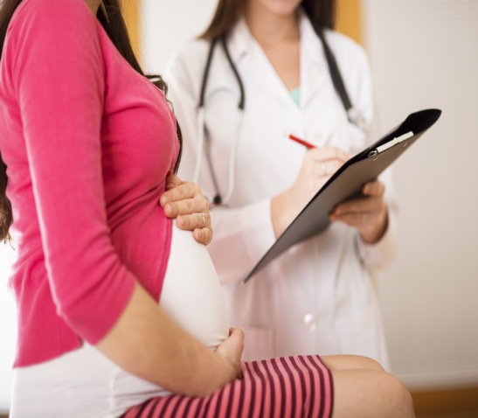
Meds & Pregnancy
- 50% > 4
- CDC true known risk
  - 10%
Mitchel Am J Obstet Gynecol 2011
Notes:
70% 1 drug
https://www.ncbi.nlm.nih.gov/pmc/articles/PMC3793635/
Mitchell AA, Bilboa Z
70% TAKE AT LEAST ONE PRESCRIPTION
https://www.cdc.gov/pregnancy/meds/treatingfortwo/data.html

Slide 87
Men are more likely to get this if they collapse in public

Slide 88
CPR
next

Slide 89
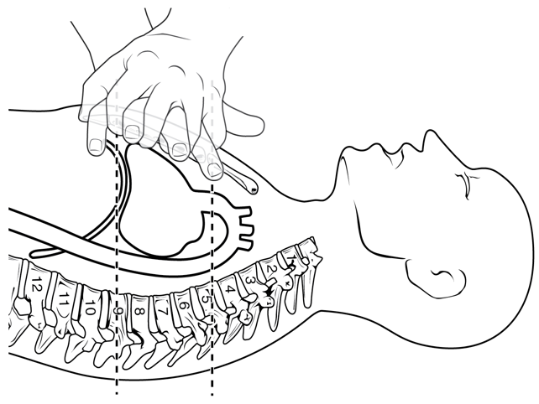
Men: 45%
Women: 39%
Odds of overall survival 23% greater in men
Brewer 2017 AHA national meeting
Notes:
https://news.heart.org/gets-cpr-bystanders-depends-man-woman/
No differences at home both sexes received about 35%
Researchers analyzed 19,331 cardiac events that occurred between 2011 and 2015 and released their preliminary results Saturday at American Heart Association’s Scientific Sessions.
“CPR involves pushing on the chest so that could make people less certain whether they can or should do CPR in public on women,” said Audrey Blewer, M.P.H., the study’s lead author and assistant director for educational programs at the Center for Resuscitation Science at the University of Pennsylvania in Philadelphia.
The data for the study was compiled by the Resuscitation Outcomes Consortium, a network of regional clinical centers in the United States and Canada that study out-of-hospital treatments of cardiac arrest and trauma.

Slide 90
Women who are taking a(n) _____ appear to have less severe symptoms after a concussive hit*
Notes:
Answer is abbreviation

Slide 91
OCP
next

Slide 92
TBI
Differences in
- Prevalence
- Cluster of symptoms
- G force thresholds
- Neck strength
- Hormonal influence
next

Slide 93
Progesterone withdrawal theory
- TBI screws up HPG
next

Slide 94
Most vulnerable

Slide 95


Slide 96
Double 123
A recent popular BMJ article, humorously focused on this ”gendered infectious condition” & underscored how even common illnesses can affect men and women differently
Notes:
Answer is an abbreviation for a class of commonly taken medications

Slide 97
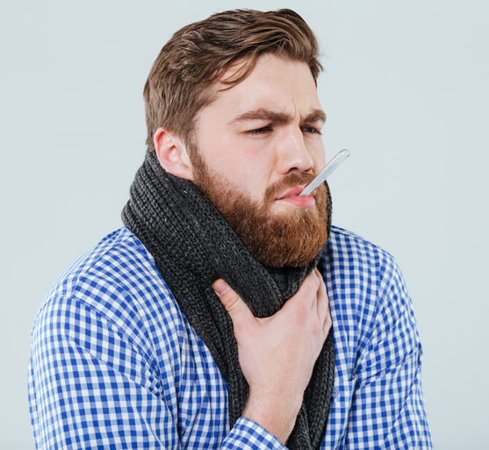
“Man Flu”
Sue BMJ 2017
Next

Slide 98
Flu
Men
  decreased immune response
  vaccine less effective
  higher smoking rates
  less likely to see doctor
  greater death rate*
Notes:
Pregnant women also vulnerable
Although animal and in-vitro studies are weak sources of evidence, human research also points to different responses to influenza in men and women. Even the World Health Organization stresses that “sex should be considered when evaluating influenza exposure and outcomes.”13 Epidemiological data from 2004-10 for seasonal influenza in Hong Kong showed that adult men had a higher risk of hospital admission,14 and in a US observational study of influenza mortality from 1997 to 2007, men had higher rates of influenza associated deaths compared with women in the same age groups. This was true regardless of underlying heart disease, cancer, chronic respiratory system disease, and renal disease.15
Studies of influenza vaccination suggest that women are more responsive to vaccination than men.1617 This is supported by the finding that women report more local and systemic reactions to influenza vaccine than men in questionnaires.18 One study noted that men with higher testosterone levels had more down regulation of antibody response to vaccination, suggesting an immunosuppressive role for testosterone.16 This is consistent with animal and in-vitro studies showing testosterone has an immunosuppressive effect1920 and a finding of higher levels of inflammatory cytokines in men with androgen deficiencies than in healthy controls.21

Slide 99
Men are more likely to have this syndrome

Slide 100
Brugada’s Syndrome
Shimizu J Cardiovascular Electrophysiology 2007

Slide 101
The acronym SCAD stands for this STEMI mimicker that affects younger women who are often postpartum and without cardiac risk factors
Notes:
diabetes increases ACS risk 5x in women as compared to 2-3x in men so two fold compared to men. the slide was not clear on this

Slide 102
Spontaneous Coronary
Artery
Dissection
next

Slide 103
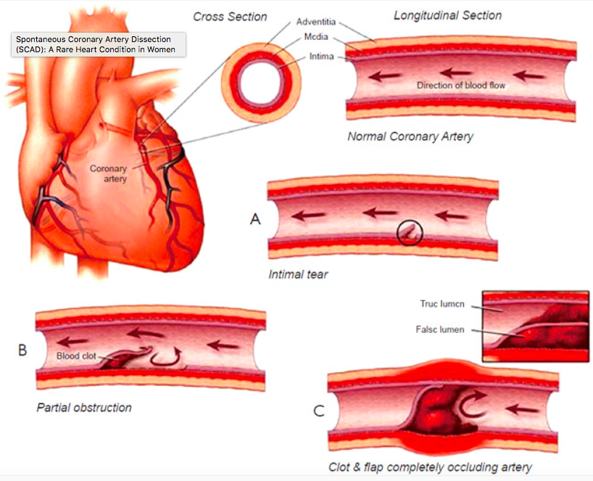
Stenting may worsen
Photo womenfitness.net

Slide 104
By developing a standardized STEMI protocol Cleveland Clinic dramatically decreased their _______ gap in 30 day mortality

Slide 105
Gender Gap
Next
Notes:
Answer is an commonly used abbreviation

Slide 106
Huded J Am Coll Cardiology 2018
Cleveland Clinic Consult QD
next
Notes:
https://consultqd.clevelandclinic.org/stemi-protocol-bridges-gender-gap-in-care-and-outcomes/

Slide 107
Protocol
Standardized cath activation
STEMI safe handoff checklist
Immediate transfer to open room
Radial artery access
Huded J Am Coll Cardiology 2018

Slide 108
This “octopus pot” syndrome is demonstrated by apical sparing on ultrasound

Slide 109
Takotsubo
Cardiomyopathy
physiopedia.com
Next
Notes:
Wetherill and senior author Teresa Franklin, PhD, a research associate professor of Neuroscience in Psychiatry, have been studying the brains of premenopausal women who smoke cigarettes for several years in Penn's Center for the Studies of Addiction. Their work is based on a significant animal literature showing that the natural sex hormones -- estrogen and progesterone -- which fluctuate over the course of the menstrual cycle modulate addictive behavior. The animal data show that during the pre-ovulatory, or follicular phase of the menstrual cycle, when the progesterone-to-estrogen ratio is low, women are more likely to be spurred toward addictive behaviors. Alternatively, during the early pre-menstrual or luteal phase of the menstrual cycle, when the progesterone-to-estrogen ratio is high, addictive behaviors are thwarted, suggesting that progesterone might protect women from relapsing to smoking.
In the current study, 38 physically healthy, premenopausal women who smoke and who were not taking hormonal contraceptives, ranging from 21 to 51 years of age, received a functional MRI scan to examine how regions of the brain that help control behavior are functionally connected to regions of the brain that signal reward.
The researchers theorized that the natural fluctuations in ovarian hormones that occur over the course of the monthly menstrual cycle affect how women make decisions regarding reward -- smoking a cigarette -- and so-called "smoking cues," which are the people, places and things that they associate with smoking, such as the smell of a lit cigarette or going on their coffee break. These "appetitive reminders" to smoke are perceived as pleasant and wanted, and similar to cigarettes, are also rewarding.
In 2015, the researchers showed that compared to when women are in the luteal phase of their menstrual cycle, which is the period of time following ovulation and prior to menstruation, women in the follicular phase -- which begins at menstruation and continues until ovulation -- have enhanced responses to smoking cues in reward-related brain regions. This finding led them to further test whether groups differed in the strength of the functional connections that exists between regions exerting cognitive control and reward-related brain regions. The weaker the functional connections between cognitive control brain regions and reward signaling brain regions, the less ability women have to 'Just Say No' when attempting to quit.
Lower ration of progesterone to estrogen

Slide 110
Takotsubo Syndrome
Catecholamine surge
> 80% in women but men may have worse outcome
Murakaim PLoS one 2015
Notes:
https://www.ncbi.nlm.nih.gov/pmc/articles/PMC4552760/
However, composite cardiac events, such as severe pump failure, serious ventricular arrhythmias, and cardiovascular death were significantly more common in male than female patients, suggesting these potentially fatal
However, composite cardiac events, such as severe pump failure, serious ventricular arrhythmias, and cardiovascular death were significantly more common in male than female patients, suggesting these potentially fatal

Slide 111
This cardiovascular disease is currently grossly under-diagnosed because it involves more distal vessels and can easily be missed by a standard cardiac cath

Slide 112
Microvascular Disease
- Hypertrophy
External compression
Abnormal reactivity
Endothelium dysfunction
Next

Slide 113

Microvascular disease
No good biomarkers
“Clean cath”
  Pet scan/MRI
Nitrates don’t work
Increased morbidity
Notes:
More likely to occur in women

Slide 114


Slide 115
This drug, used for enuresis and certain bleeding disorders, has increased risk of hyponatremia and seizures in women and now has sex specific dosing in Europe
Question originally recorded by Dr. Cara Tannenbaum
Start Timer
GO TO
ANSWER
(question)
Notes:
Due to size constraints on web site platform recorded questions were removed prior to game posting

Slide 116
DDAVP

Slide 117
Thank you
Twitter
@WolfeJeannette
Sexandwhy.com

Slide 118
References
AHA Scientific Statement Circulation 2016
Ali Surgical Endscopy 2015
Airaksinen J Am Coll Cardiology. 1998
Bosson JAHA 2016
Canadian Health Institute for Health Research
Chiaramonte, Health Psy 2006
Choong, Basics and Clinical Pharm & Tox 2013
Dhruva Jama Internal Med 2017
Fakih, M.G., et al, Am J Infect Contr 2010
FlycktObstetrics and Gyn International 2017
Greenblatt 2013 Pharmakokinetics/Pharmacodynamics
Kannegaard 2009 Age and Ageing
Laan Injury 2015
Mandava Stroke 2013
Mors Immunobiology 2016

Slide 119
References
Oskui J of American Heart Association 2013
Peer, Front Pharmacol 2016
Pelletier J Am Coll Cardiology 2016
Peters Pharmacoepidemiology and Drug Safety 2013
Phillips et al Global Health Action 2016
Salles J of Amer Col of Surg 2016
Spataro j of Women’s Health 2016
Shah BMJ 2015
Schnell 2010 Geriatr Ortho Surg Rehab
Shimizu J Cardiovasc Electrophysiol. 2007
Venkatesh Archives of Internal Medicine 2012
Vlak, M (2011). The Lancet Neurology, 10(7), 626–636.
Wetherill Biology of Sex Differences 2016
Yip Cardiovasc Diag Ther 2015

Slide 120
Other websites
http://www.soc.ucsb.edu/sexinfo/article/causes
https://www.drugabuse.gov/publications/
research-reports/substance-use-in-women/
sex-gender-differences-in-substance-use
https://doi.org/10.1016/S1474-4422(11)70109-0
https://www.cdc.gov/pregnancy/meds/
treatingfortwo/data.html
https://www.drugabuse.gov/publications/
research-reports/substance-use-in-women/
sex-gender-differences-in-substance-use

